Slide 1
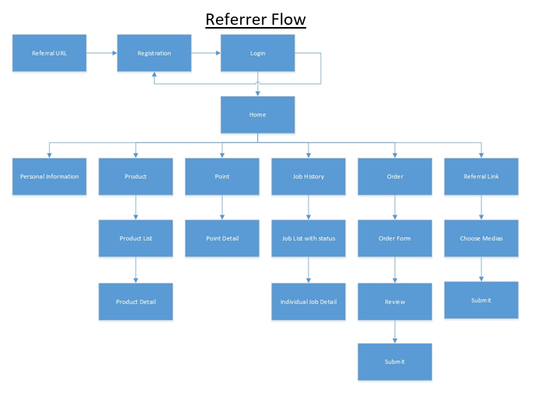
View/Add messages

Slide 2
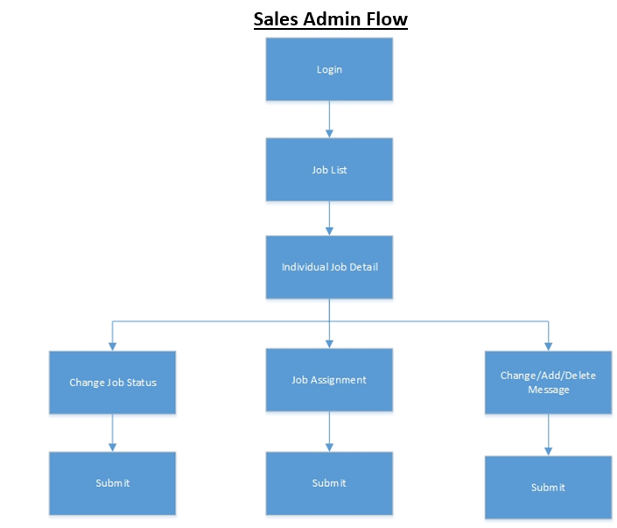
Sales List
Individual Sales Details
MACD
Individual Sales
Submit

Slide 3
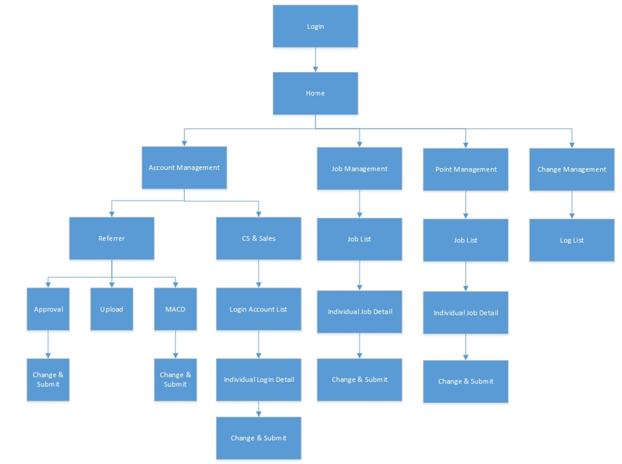
Customer Service Administration
Industry/Supplier Management List (2 separate blocks)
Point Allocation Management
CS , CS Admin & Sales
Industry / Supplier List
Change & Submit
Individual Industry / Supplier Detail
Add Messages
MACD
Change & Submit
Submit

